Slide 1
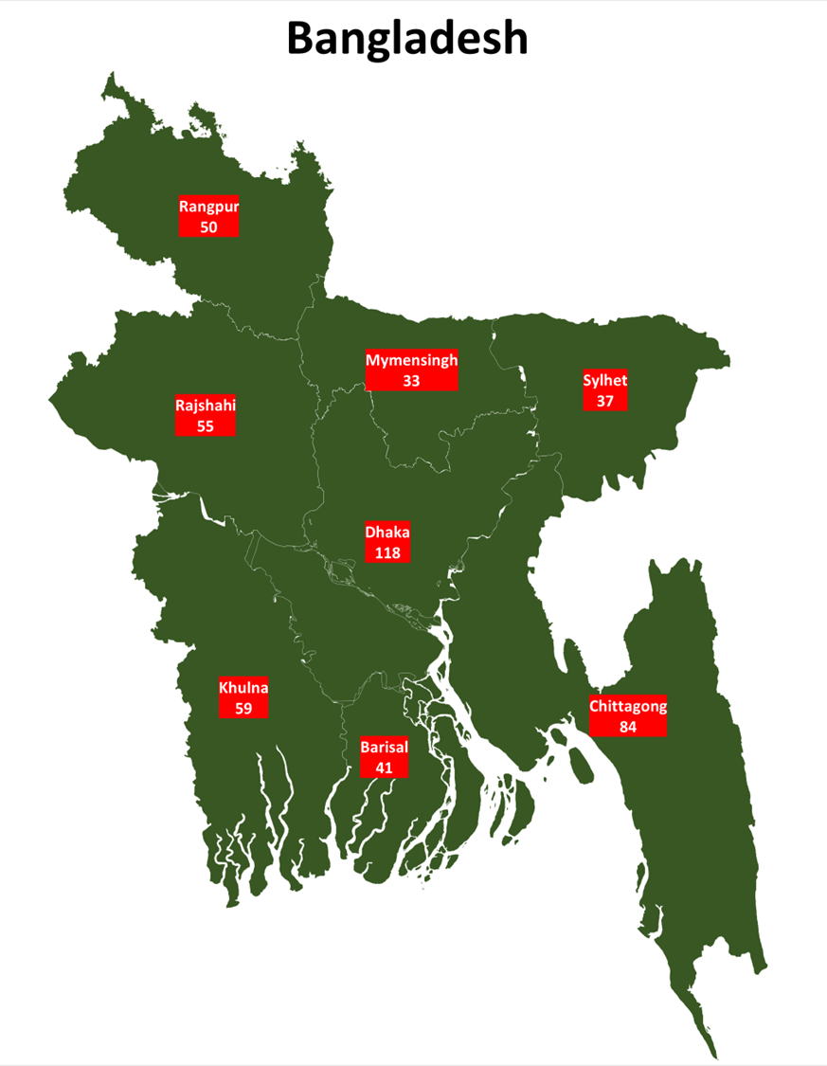
BLIMS training PPT
12 DEC 2023

Slide 2
Background
The TB laboratory network of the National Control Tuberculosis Program (NTP has an approach of three-tier laboratory network system (NRL and RTRLs and peripheral labs) for the diagnosis of TB and DR TB.
Bangladesh TB program has 6 C&DST (5 RTRLs,1 NTRL) laboratories serving various TB DST testing (Phenotypic or Molecular tests).
NTP
NTRL
HIERARCHY OF LAB REPORTING
RTRL
Peripheral sites NAAT (Gx and Truenat)
Peripheral sites Microscopy

Slide 3
Current status
Data flow recording and reporting at various levels
Microscopy centers : Paper based recording and reporting
NAAT TB testing centers: ASPECT and Paper Based
RTRLs/NTRLs : Excel and Paper Based
Gaps and Challenges
  Lack of real time reporting
  Lack of uniformity in recording reporting.
  Delay in recording and reporting to NTP.
  Tedious efforts in monitoring and evaluation
  Longer time for analysis of quality indicators for decision making.
  Lack of integrations with various software’s like E-TB Manager, DHIS-2
  Lack of capturing key indicators
  Lack Automatic generation of aggregated reports from C&DST TB Labs
  Lack Automatic output of form 6 and DR-TB10A,10B.

Slide 4
Existing status
 | NTRL/RTRL | mWRD (Xpert, Truenat) | MICROSCOPY
Recording | Excel and Hard copy Register | Hard copy register, ASPECT (Only Xpert) | Hard copy Register
Reporting patient results | Hard copy and Email | Hard copy For DSMO SMS alert for Rif Resistance cases | Hard copy
Reporting NTP | Monthly report (Google sheet) | ASPECT (Only Xpert), Monthly report (Google Sheet) | Hard copy, Excel (Qtrly)
M&E
Data compilation | Excel spread sheet | ASPECT (Only Xpert), Monthly report (Google Sheet) | Hard copy, Excel
Data Analysis | Excel based tools for indicators | ASPECT (Only Xpert), Monthly report (Google Sheet) | Hard copy, Excel
Feedback and Action Taken Report (ATR) | Meetings and Onsite | Meetings and Onsite | Meetings, Onsite through EQA controllers
Integration with HIMS | Not Available | Not Available | Not Applicable
Plans for Strengthening | B-LIMS, Integration with HIMS | Scaleup ASPECT to cover Truenat | Online indicator reporting
M&E using data | Monthly monitoring dashboards at site and NTP level, Documentation | Use Dashboards for monitoring and planning site visits | Monitor transition of Microscopy to mWRD as diagnostics

Slide 5
Objectives
Transition from Excel based to simple software tool
Data recording and reporting in a uniform manner
To provide accurate information for patient care and
public health planning policy decisions
Notification to health officials to initiate/monitor the treatment

Slide 6

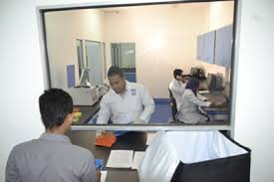
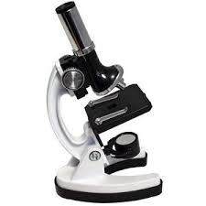
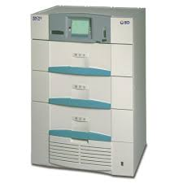
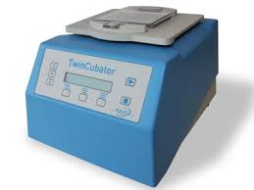
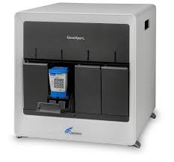
Proposed structure of Data flow movement from lab to central cloud at RTRL and NTRLs
Each Lab
RTRL/NTRL labs
Cloud
NTRL
RTRL-1
Internet
RTRL-2
Central B-LIMS Server (Admin)
RTRL-3
RTRL-4
RTRL-5

Slide 7
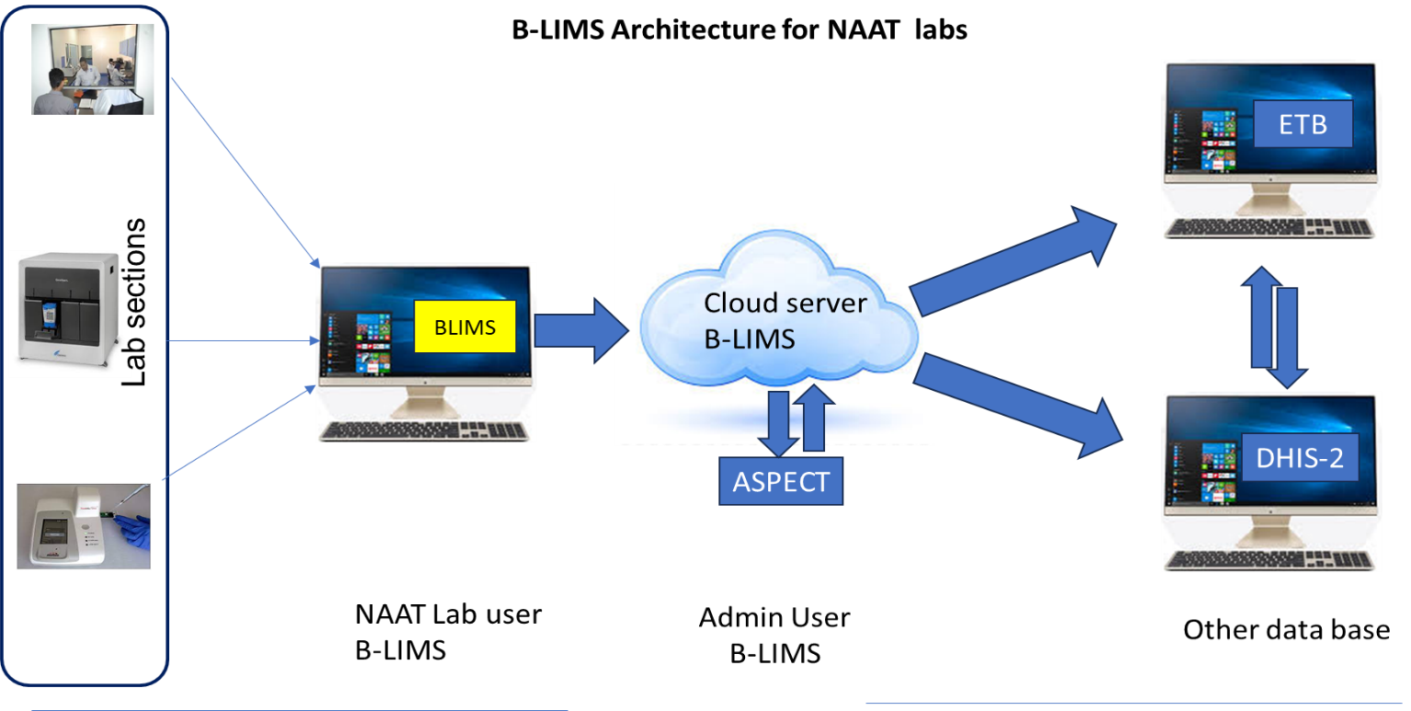
Proposed structure of Data flow movement from lab to central cloud at NAAT sites

Slide 8
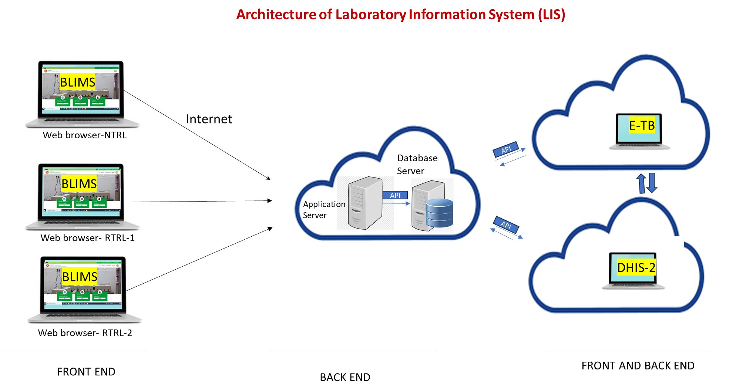
Future Proposed structure of Integrations of Various Platforms

Slide 9
B-LIMS, Lab/RTRL/NTRL Login
Truenat
Microscopy
GeneXpert (MTB/RIF) & Ultra
GenXpert XDR
Specimen Registration
1st line LPA
2nd line LPA
Culture
DST

Slide 10
LAB LOGIN
ADMIN LOGIN
Under LAB LOGIN: User can create different roles for the lab staff
Can enter the data for very lab TB test
Can download TB C&DST register
Real time monitoring by the lab incharge
Generate monthly Reports, TAT reports
Able to create roles like Lab admin users, divisional and national level
Able to monitor National level data lab wise/ all C&DST labs
Able to upload CSV files

Slide 11
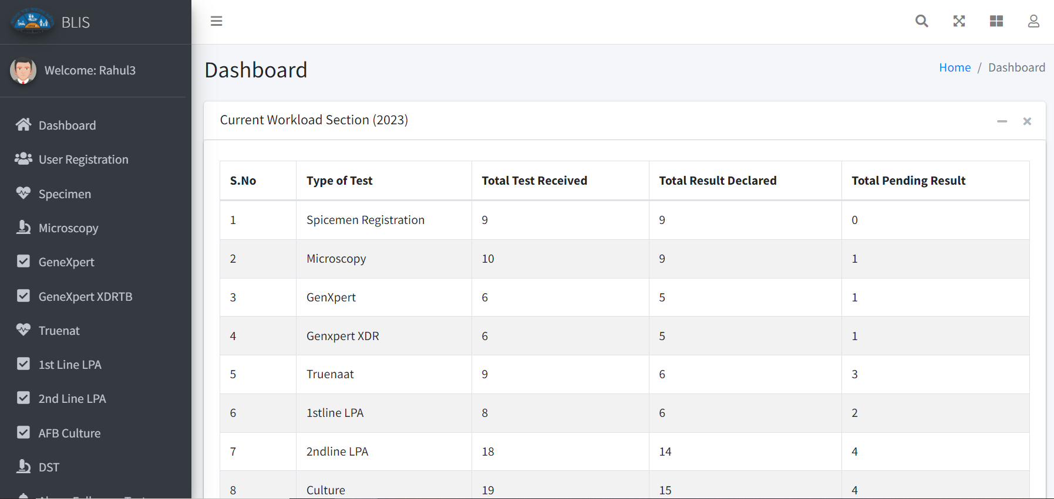

DASHBOARD

Slide 12
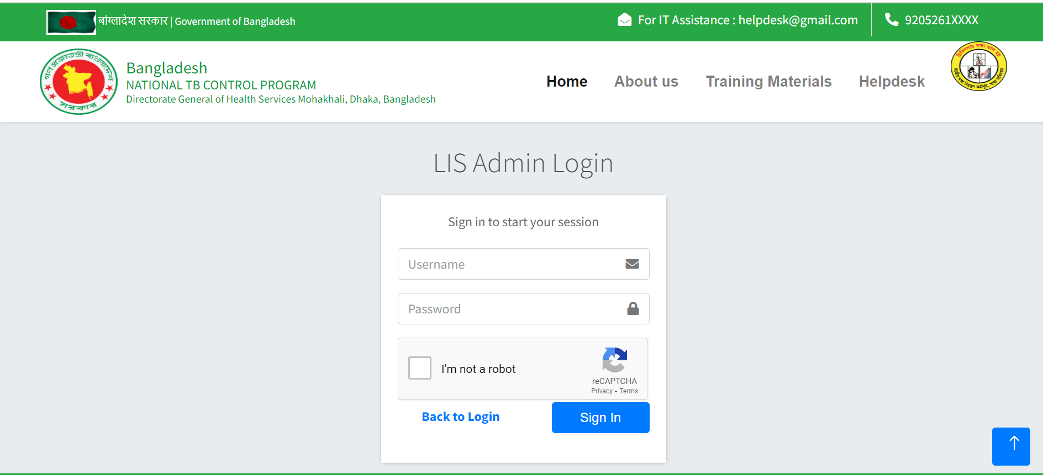
Admin LOGIN

Slide 13
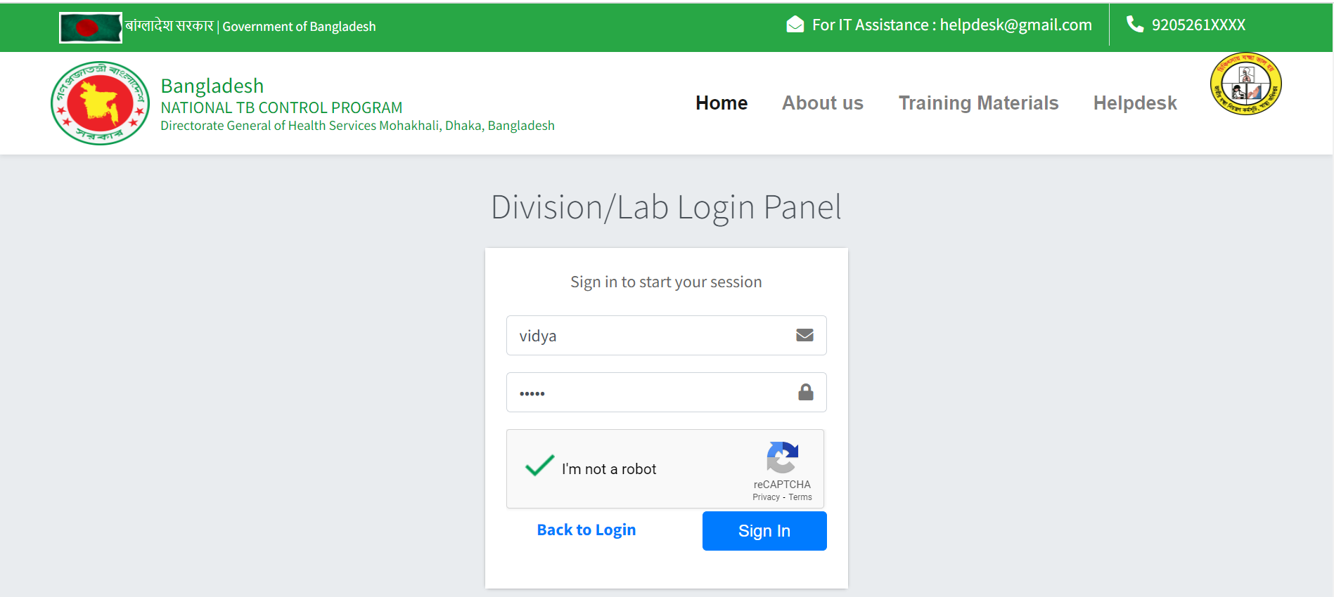
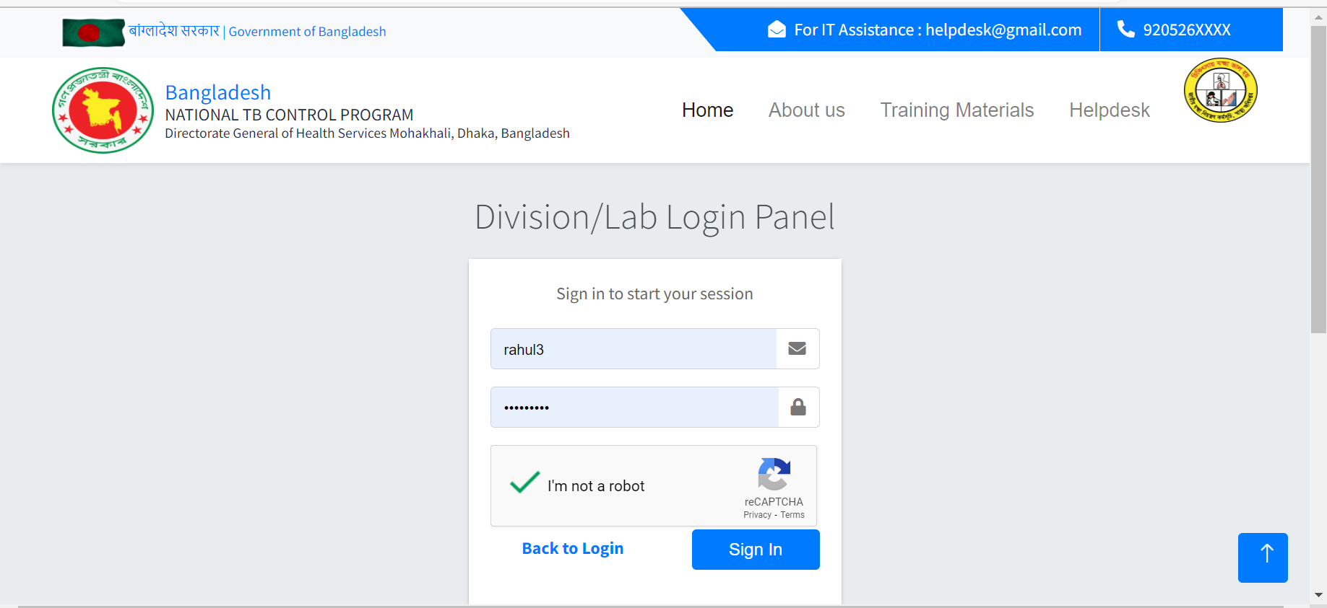
USER LOGIN

Slide 14
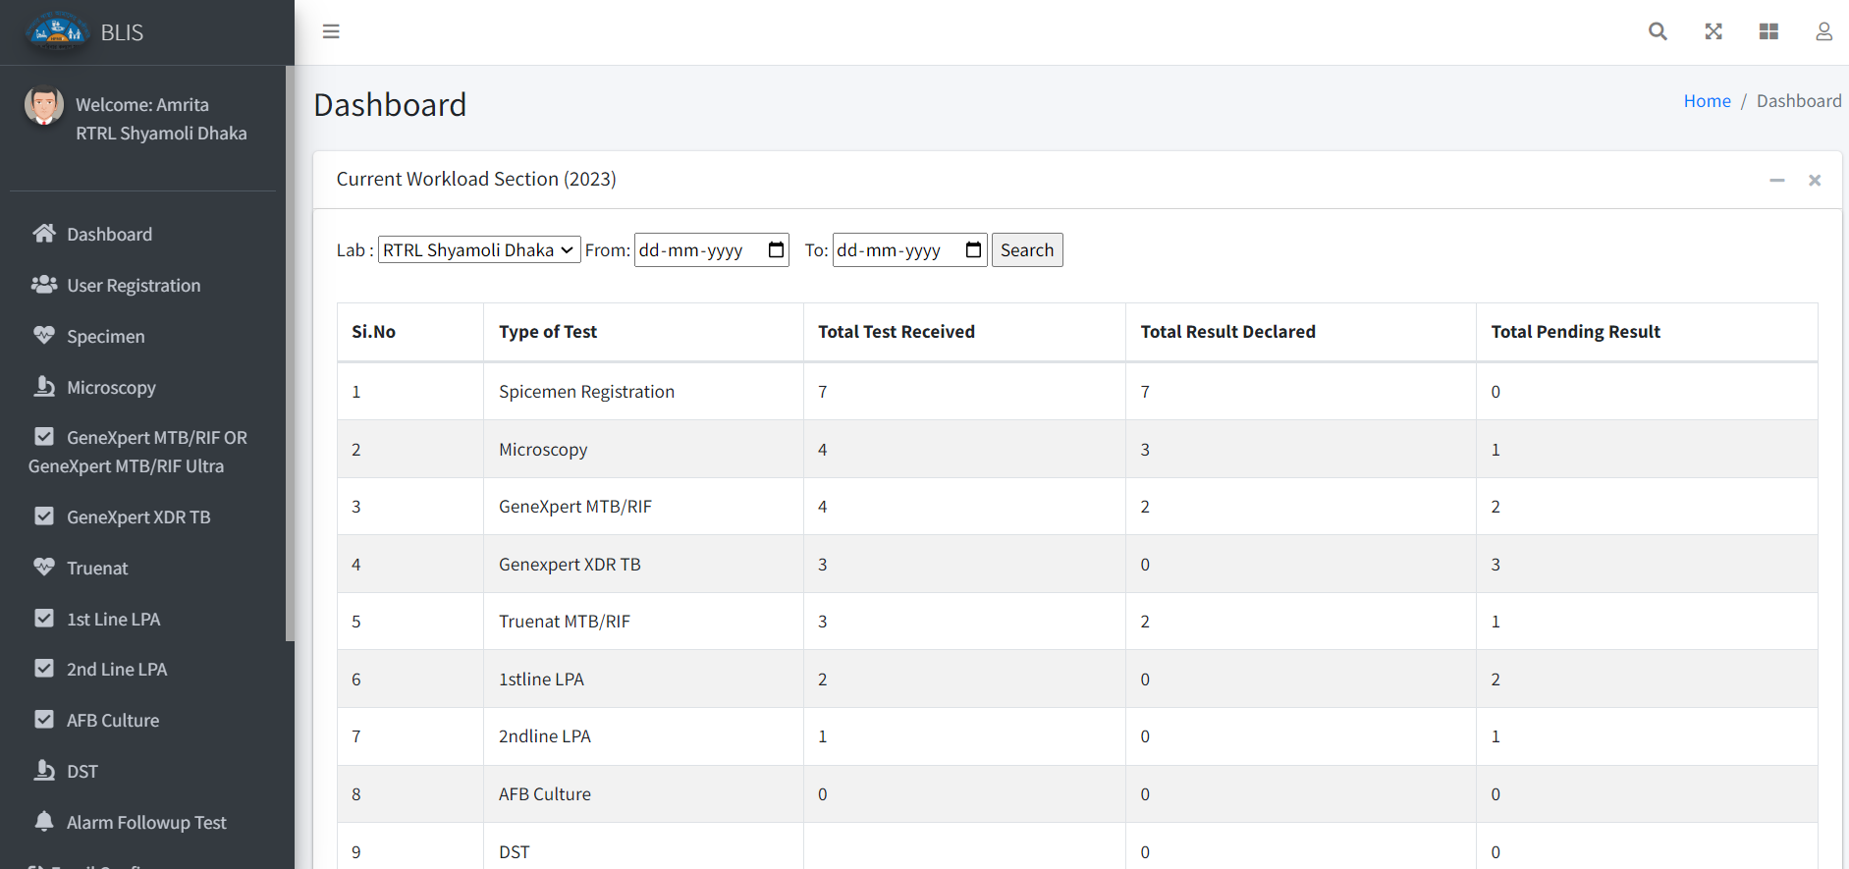
Lab Dashboard

Slide 15
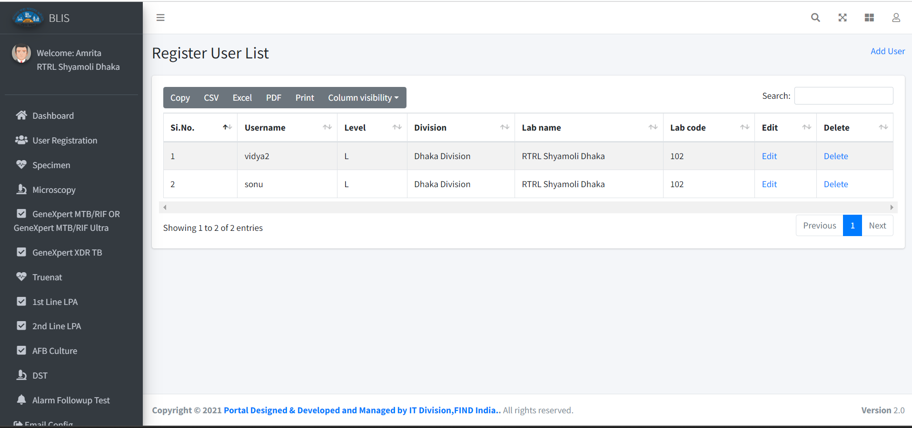
User List

Slide 16
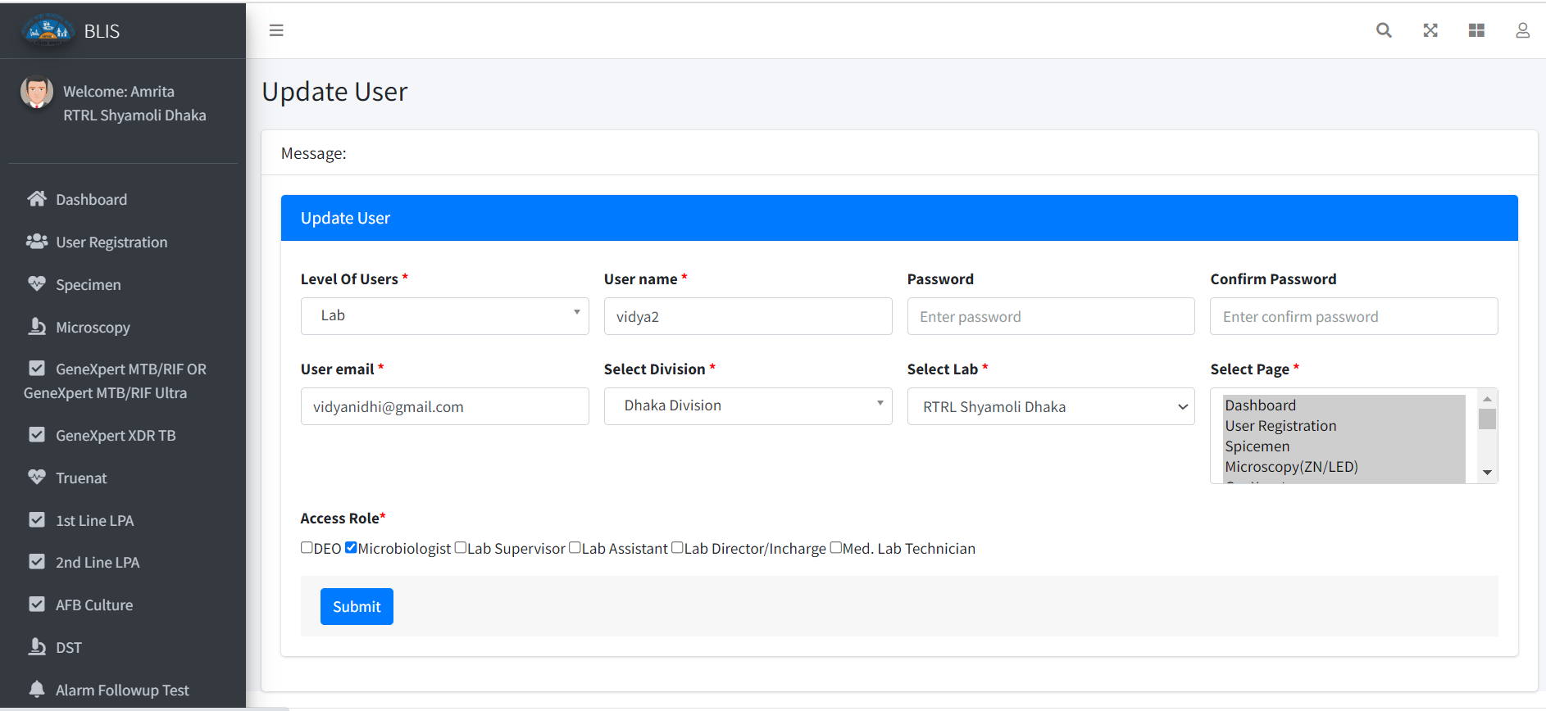
User Update

Slide 17
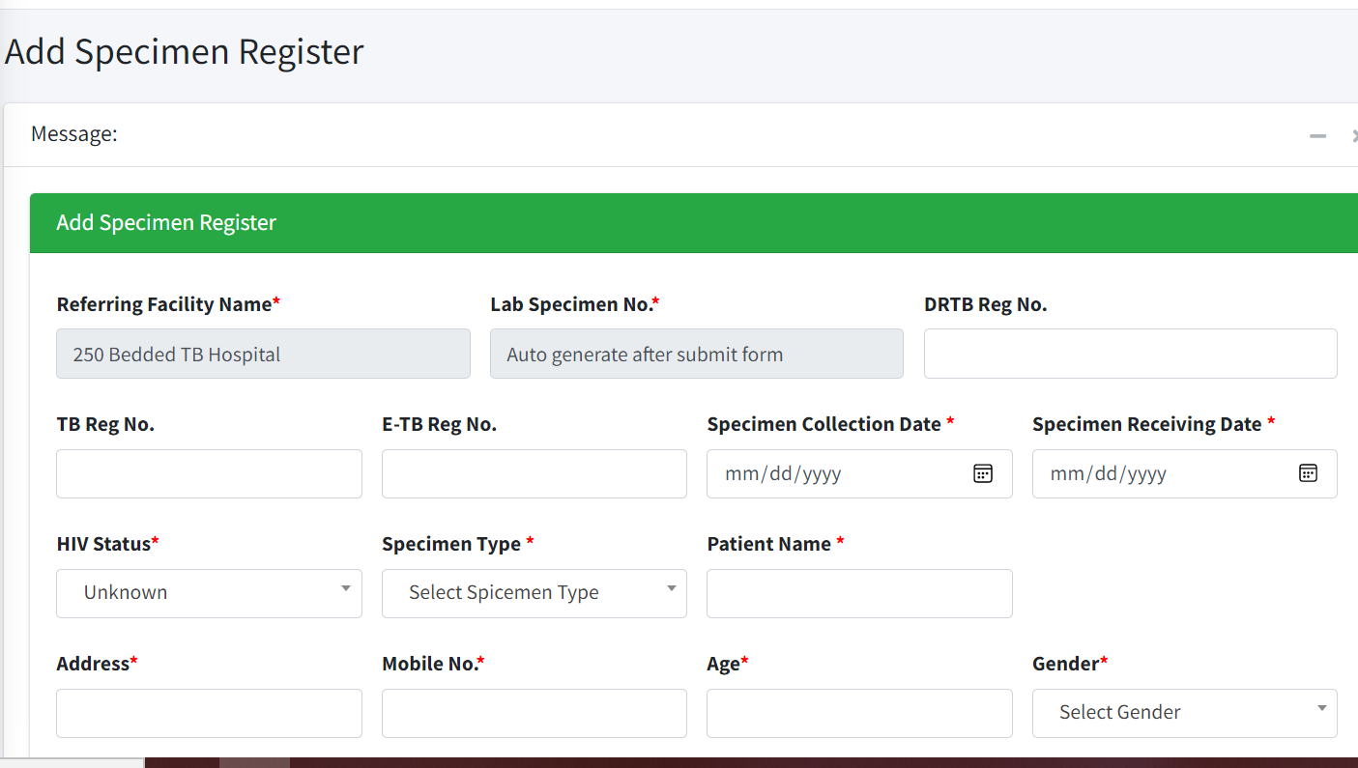
Specimen registration

Slide 18
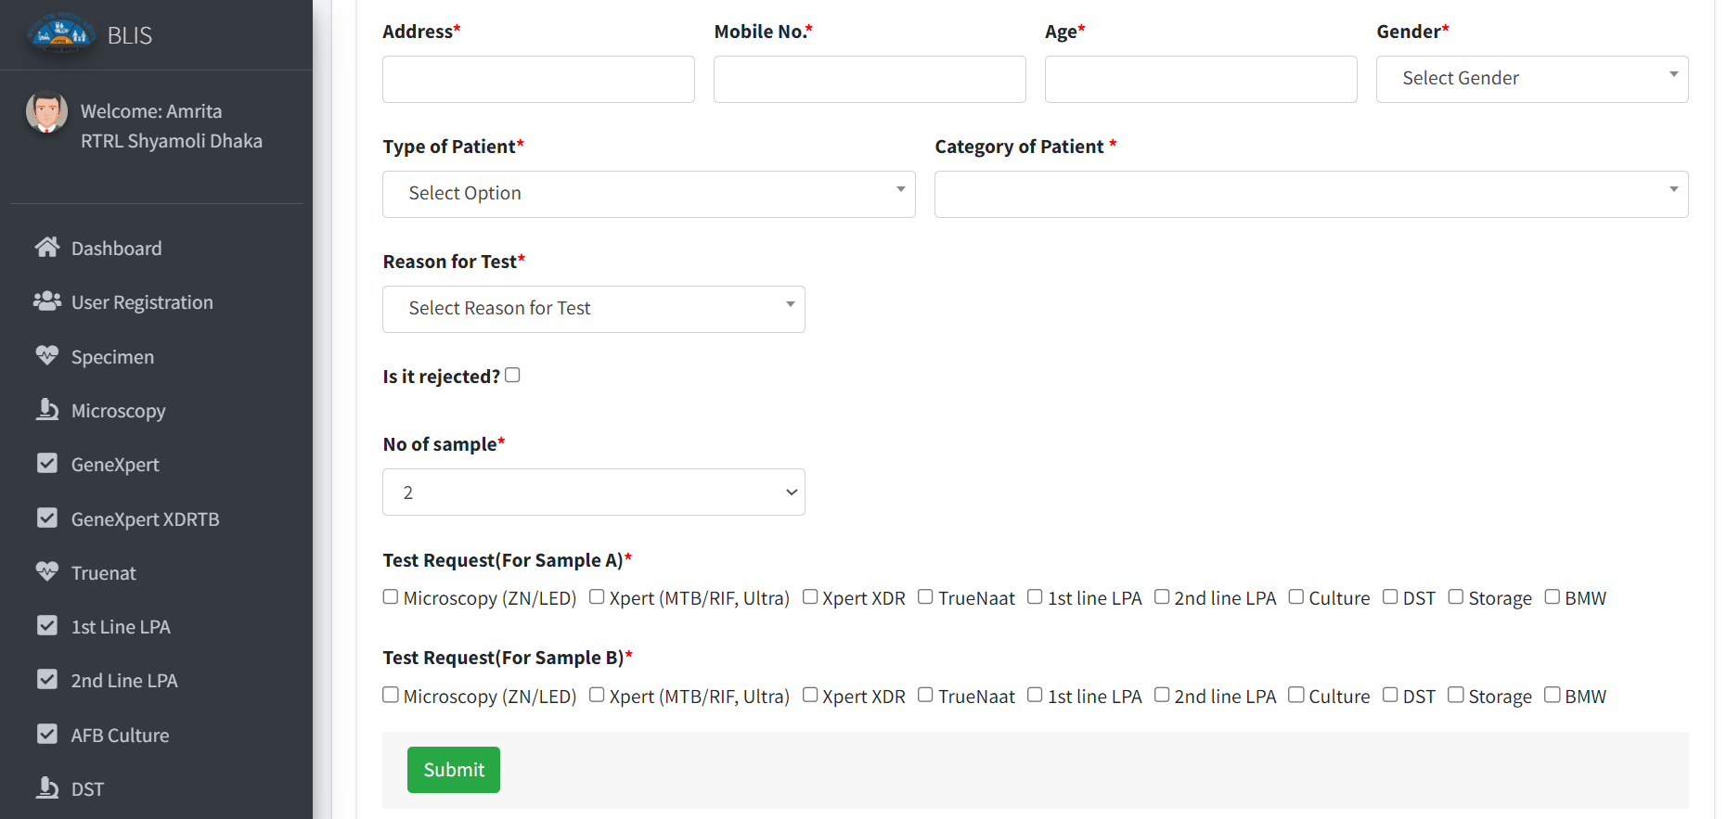
Specimen registration

Slide 19
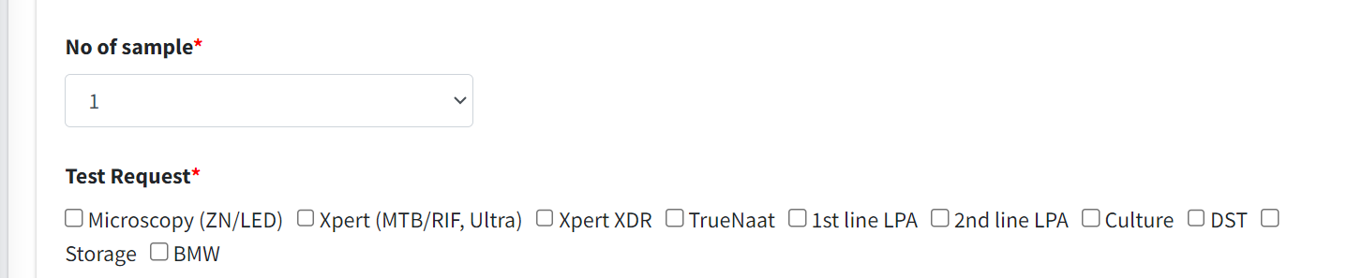
Specimen registration with 1 sample

Slide 20
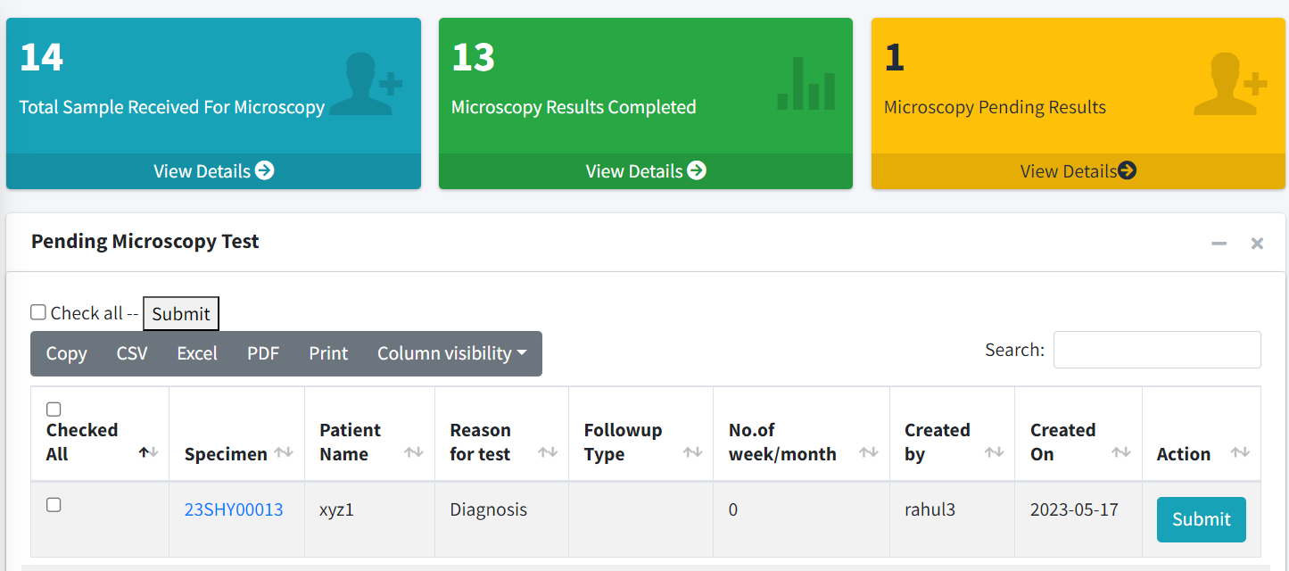
microscopy

Slide 21
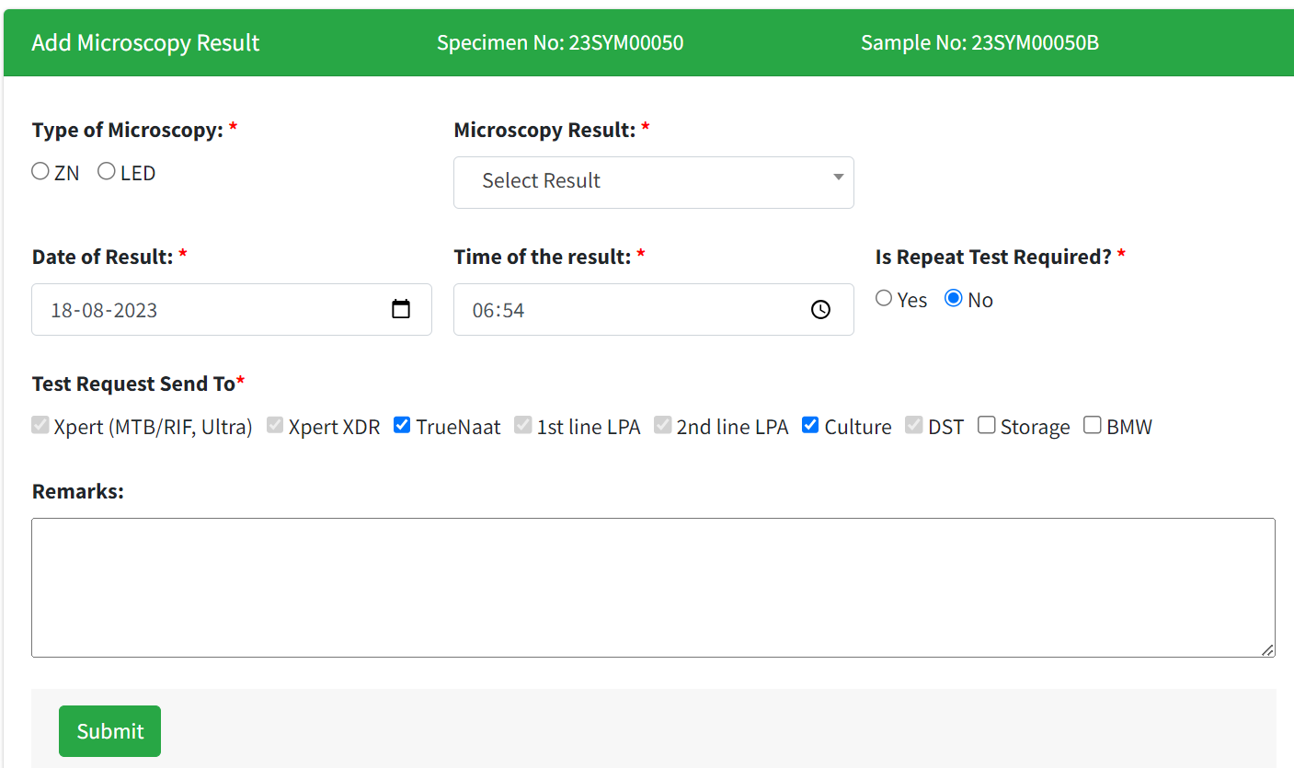
microscopy

Slide 22
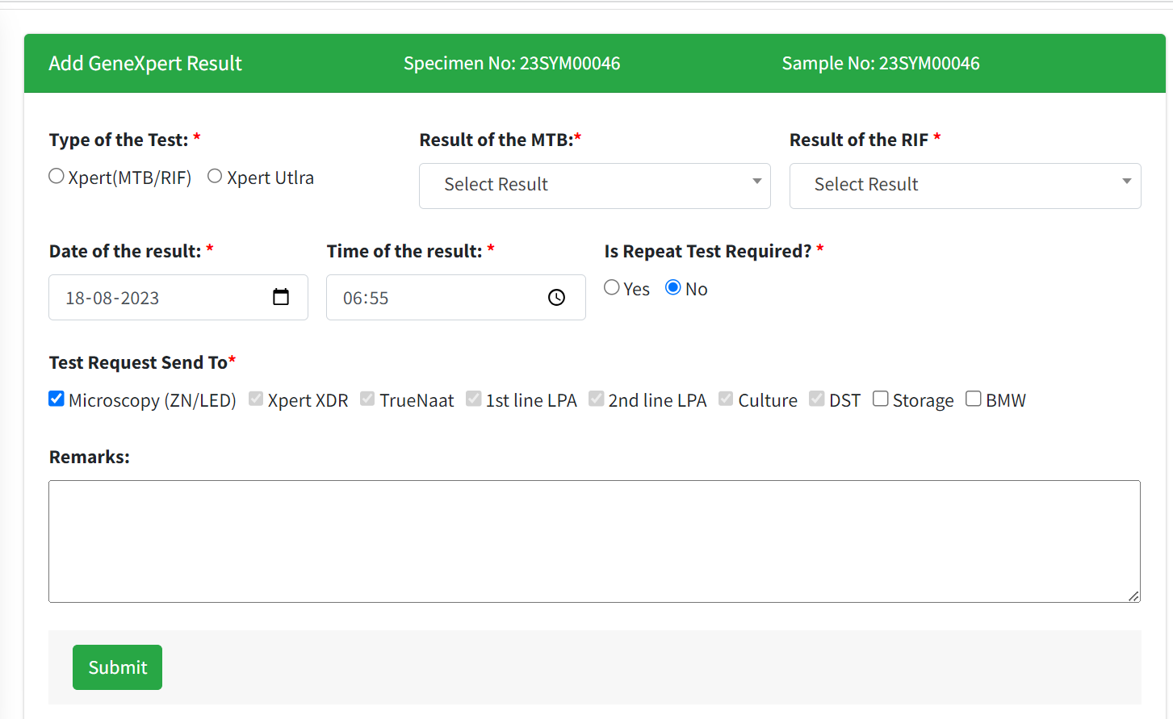
genexpert

Slide 23
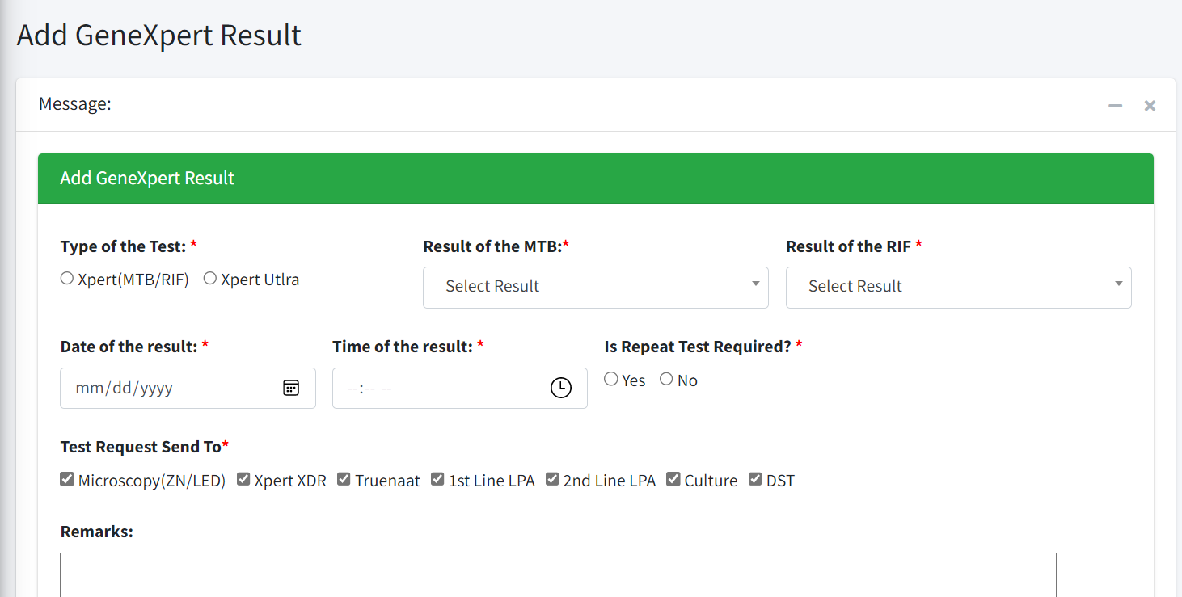
genexpert

Slide 24
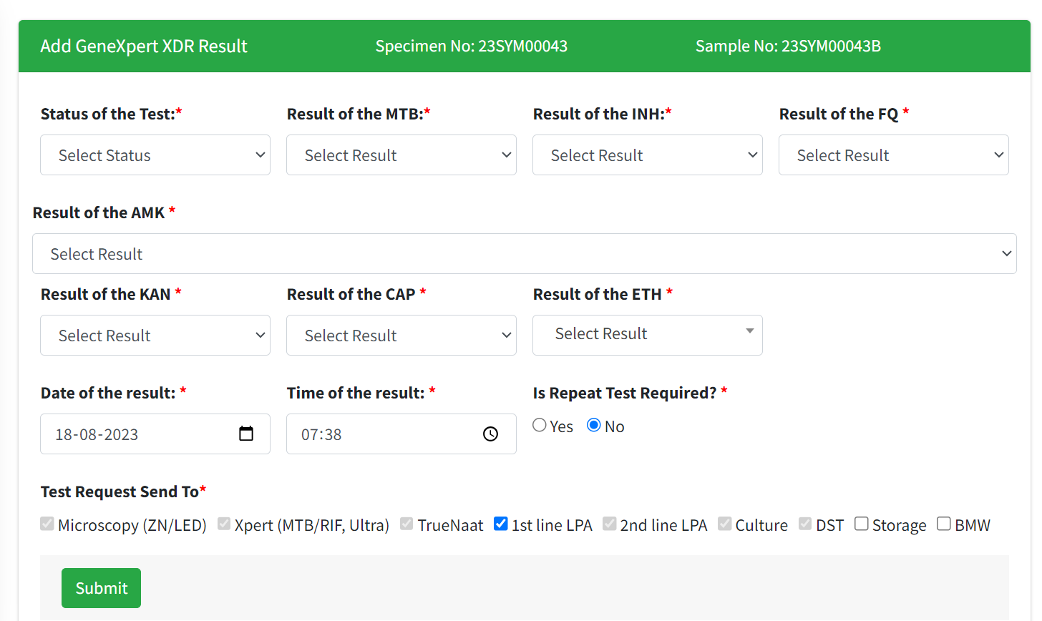
Genexpert-XDR

Slide 25
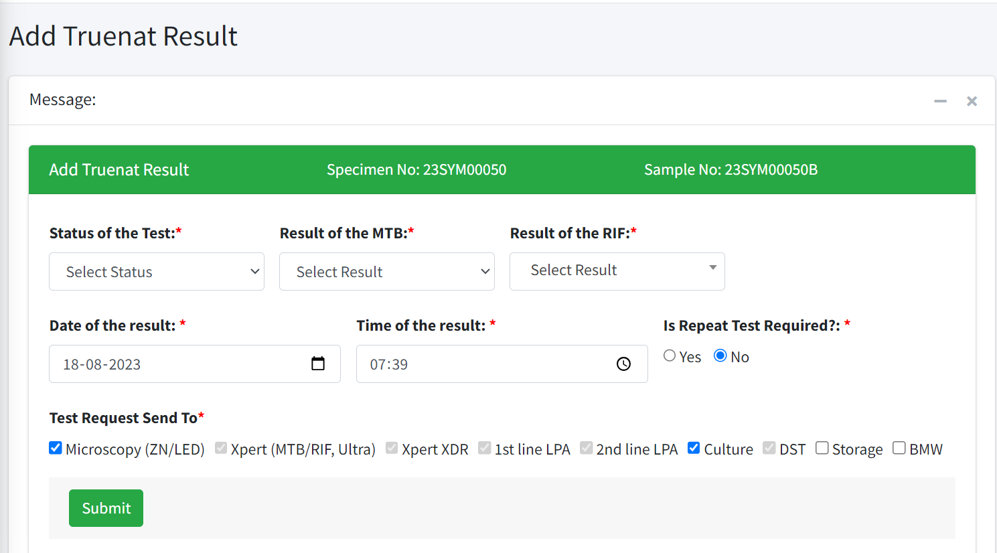
Truenat

Slide 26
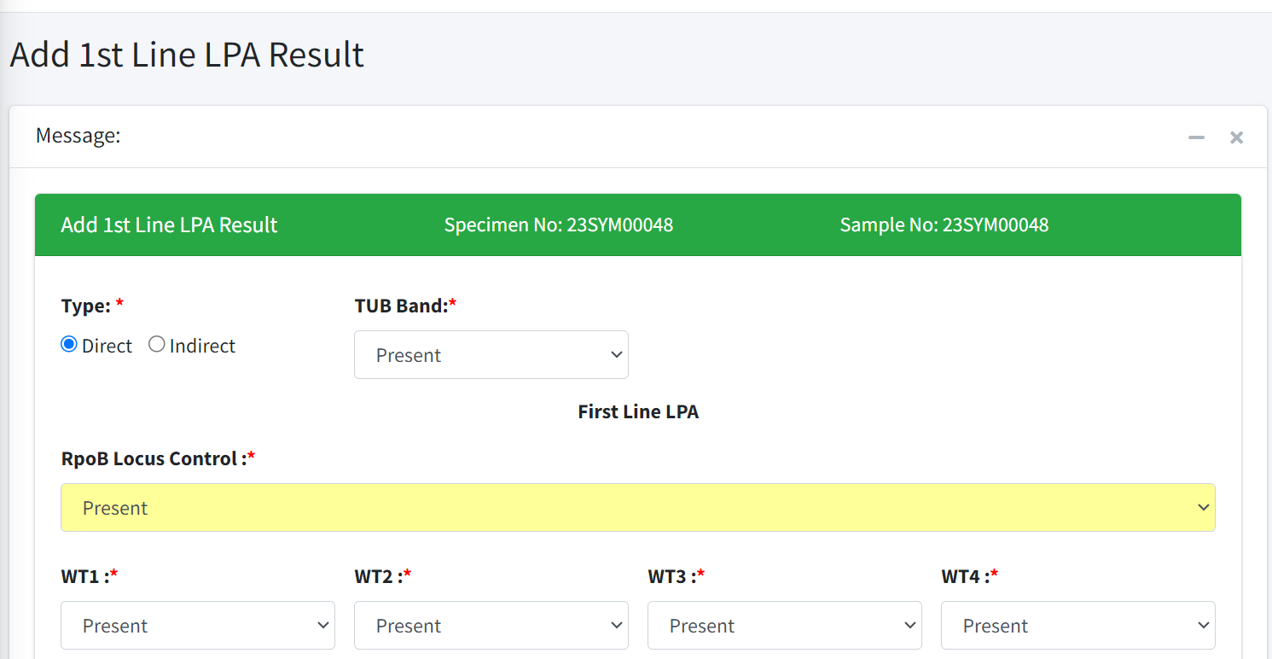
FL-LPA

Slide 27
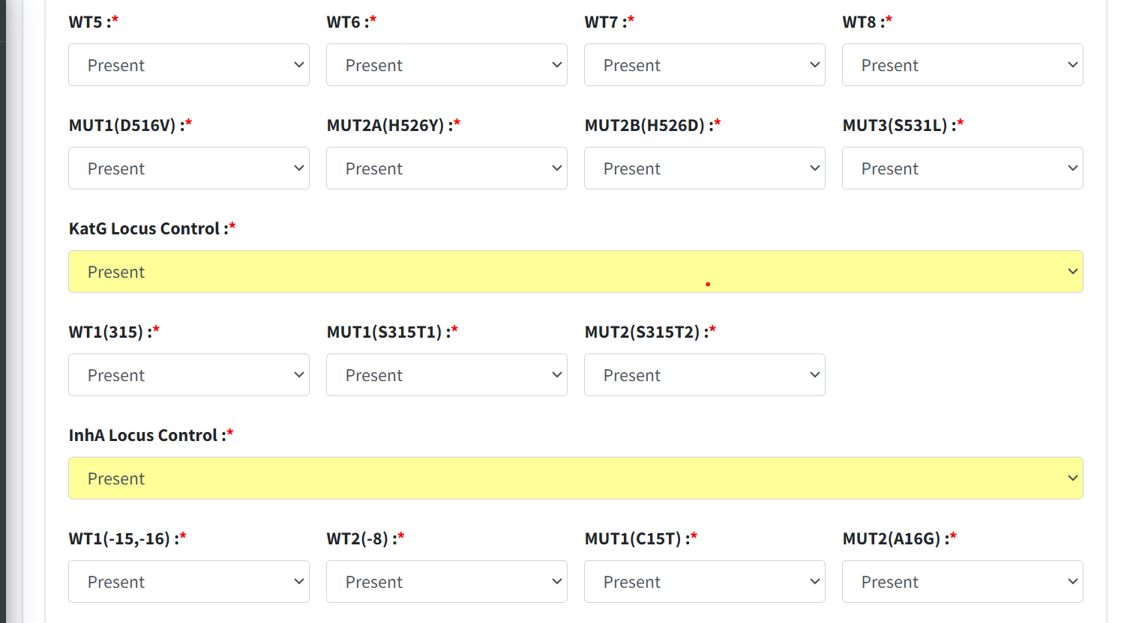
FL-LPA

Slide 28
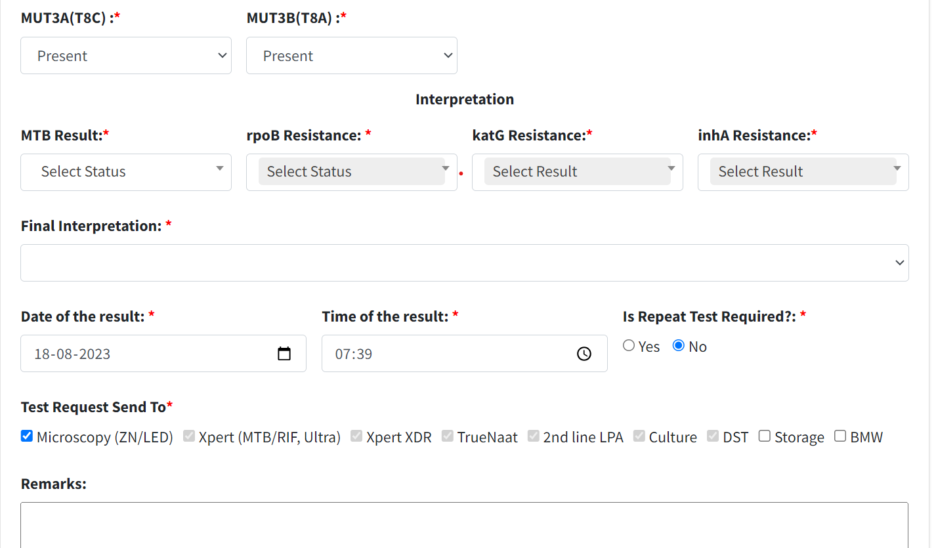
FL-LPA

Slide 29
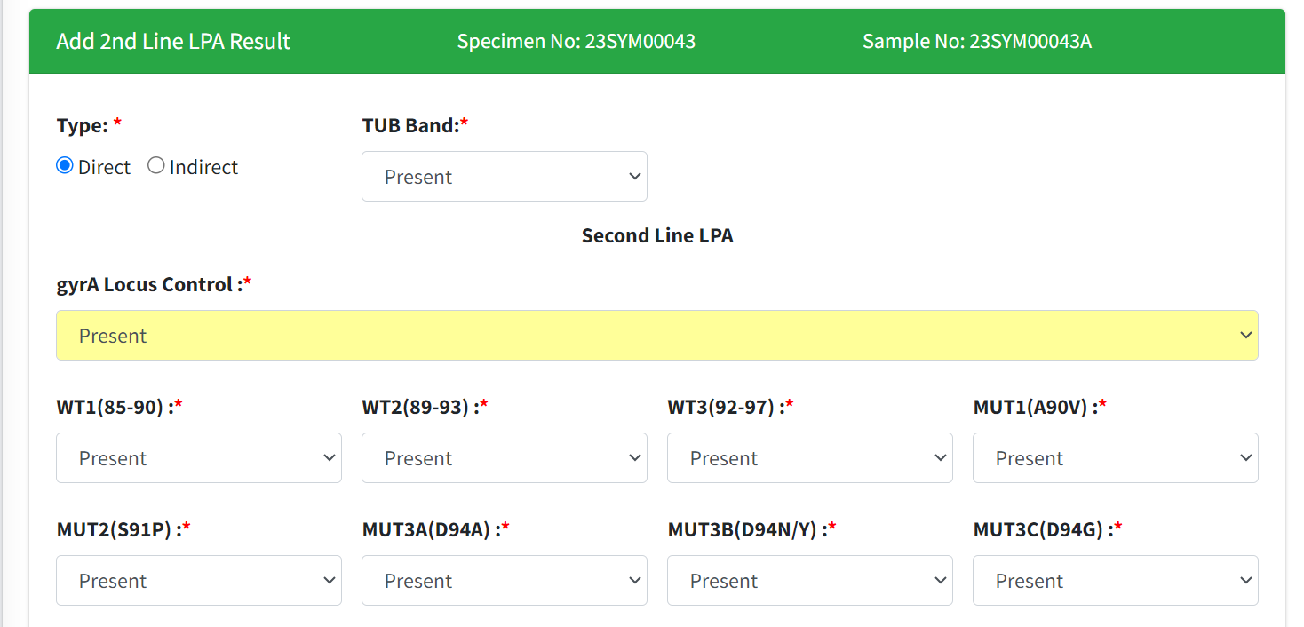
SL-LPA

Slide 30
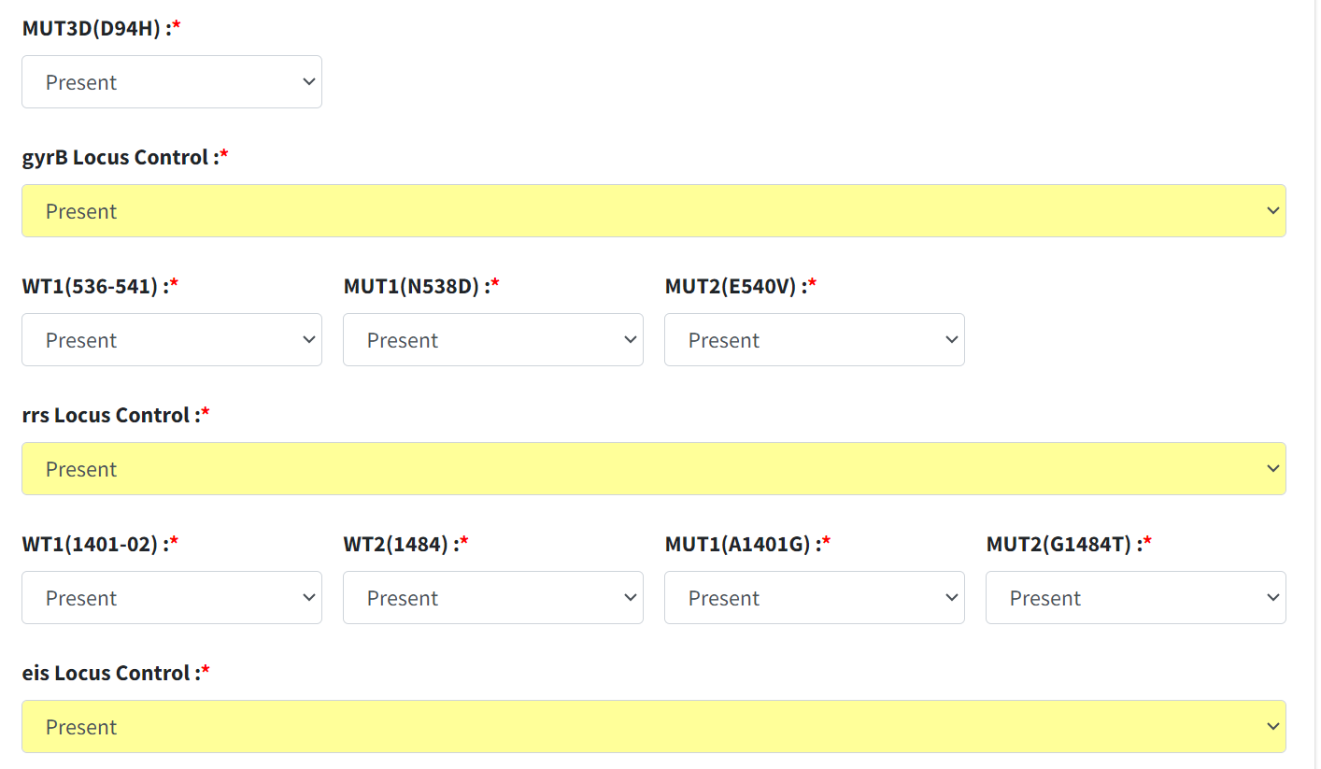
SL-LPA

Slide 31
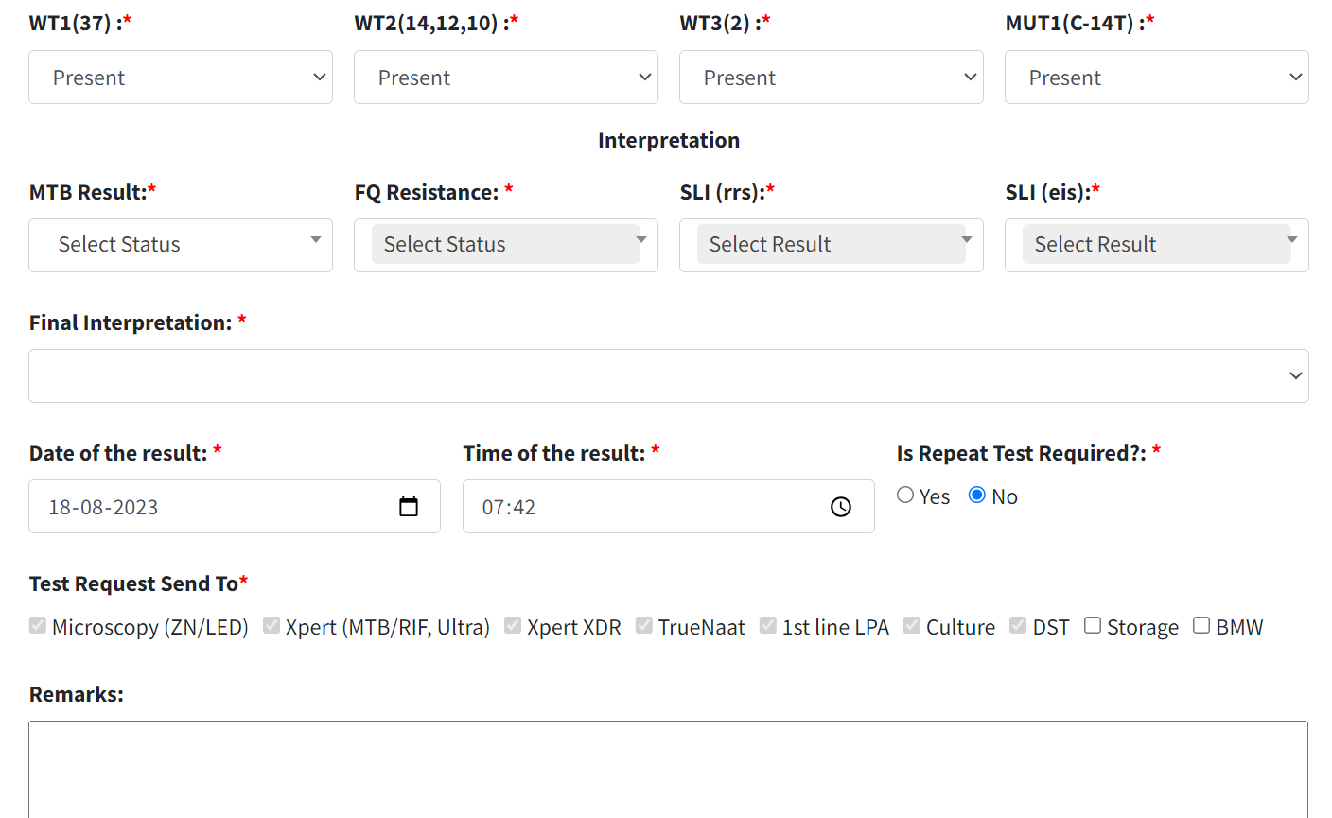
SL-LPA

Slide 32
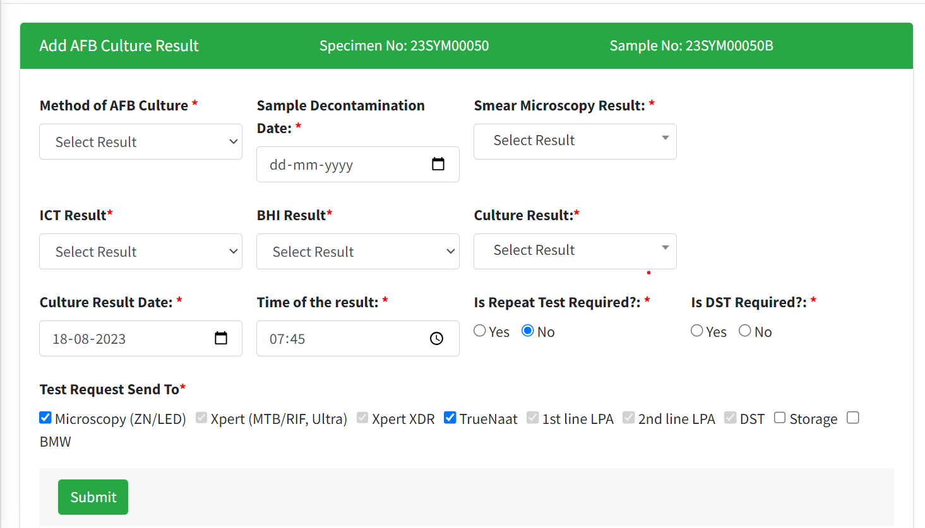
Afb CuLTURE (BOTH SOLID AND LIQUID)

Slide 33
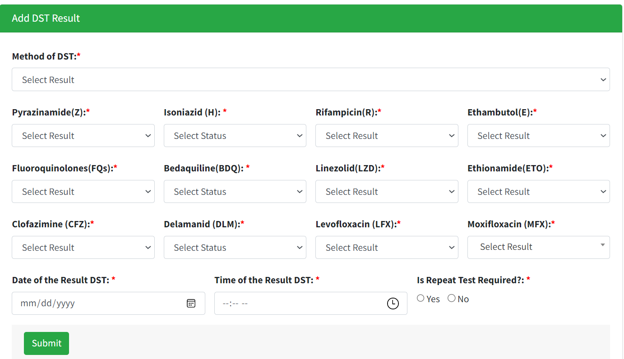
DRUG SUSCIPTIBILITY TESTING (BOTH SOLID AND LIQUID)

Slide 34
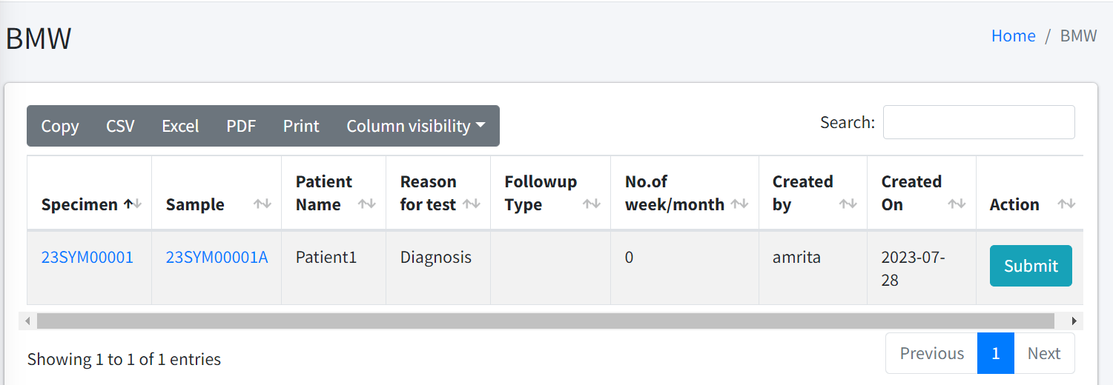
BMW LIST SAMPLE WISE

Slide 35
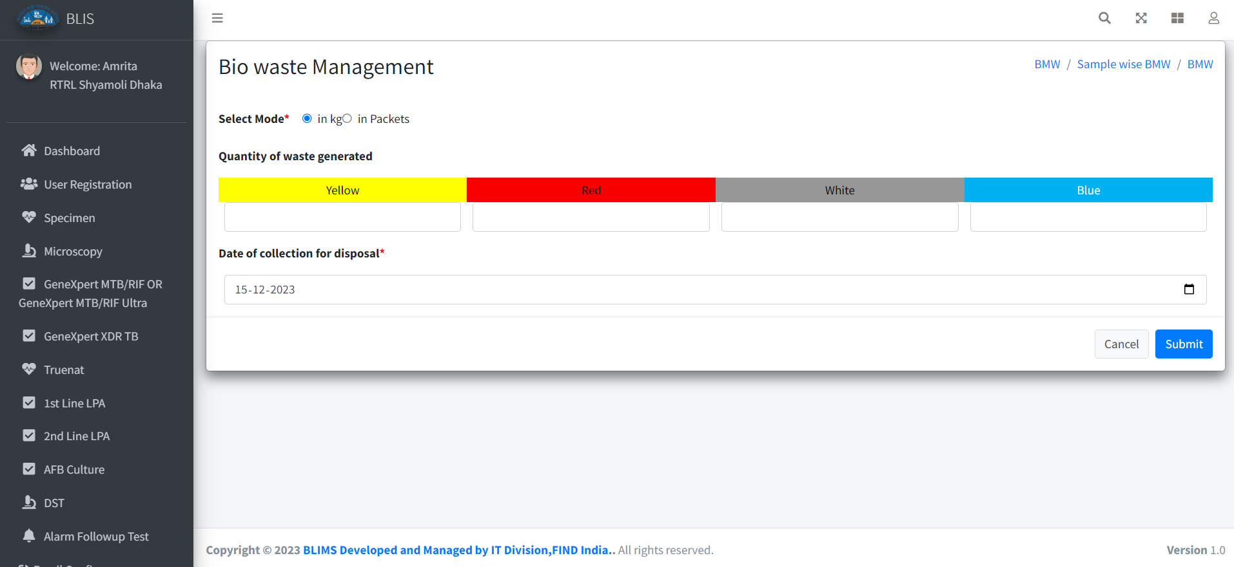
Add BMW

Slide 36
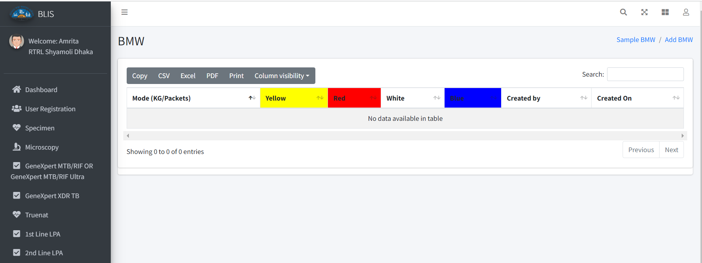
BMW LIST

Slide 37
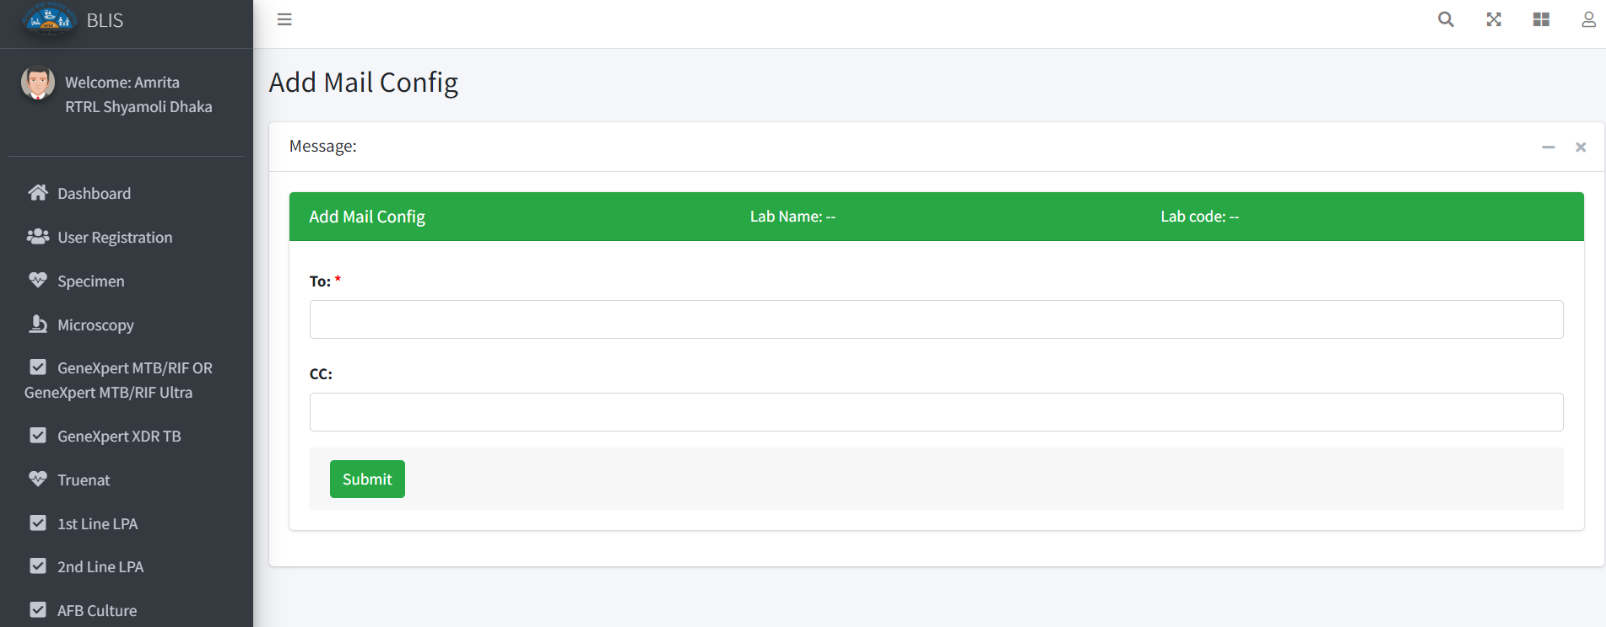
Add mail Config

Slide 38
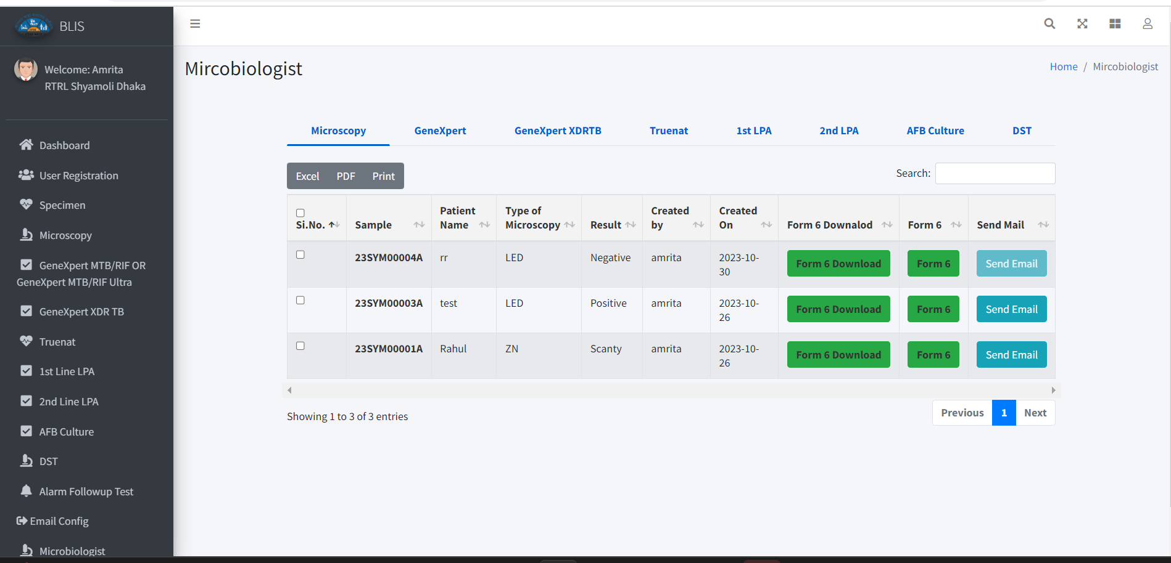
Microbiologist

Slide 39
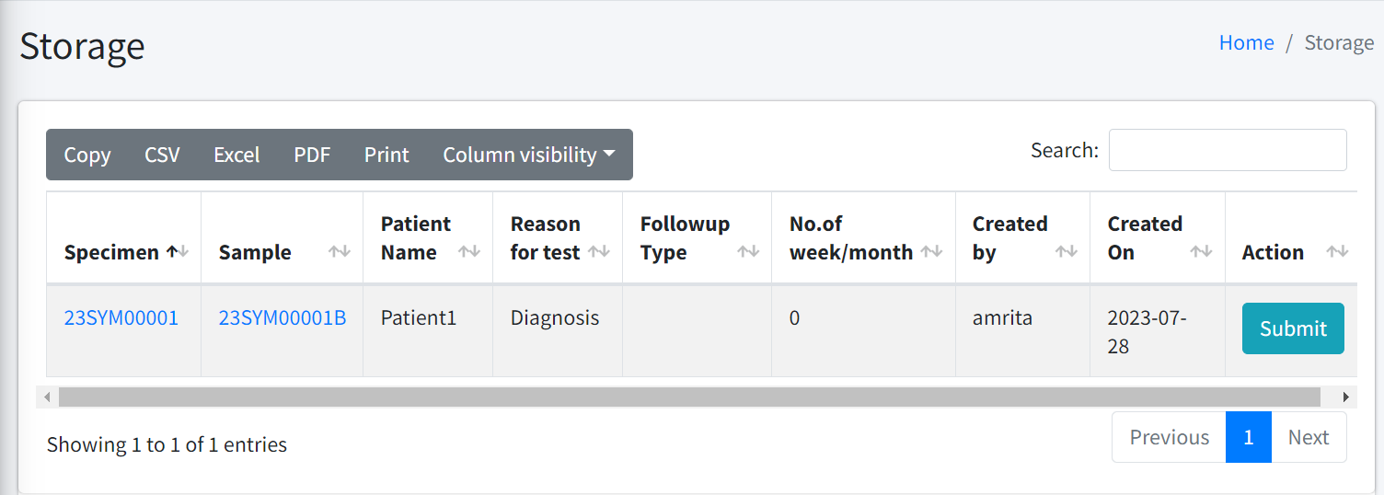
Storage LIST

Slide 40
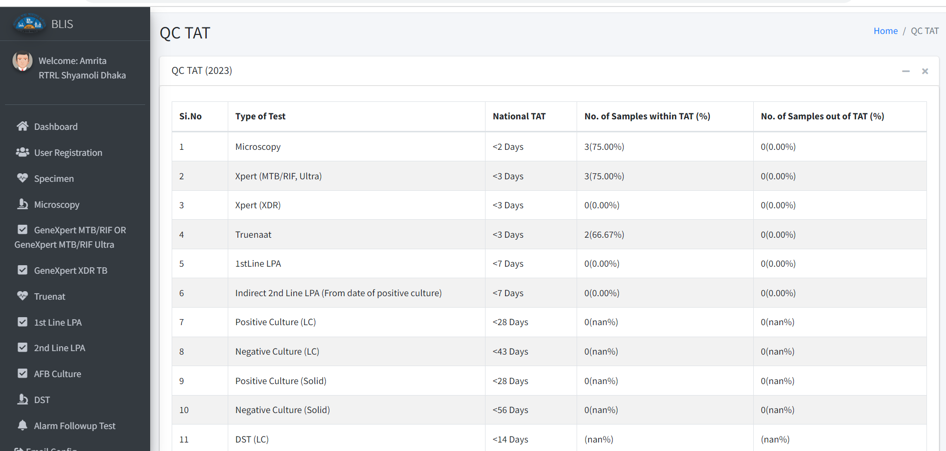
QC TAT

Slide 41
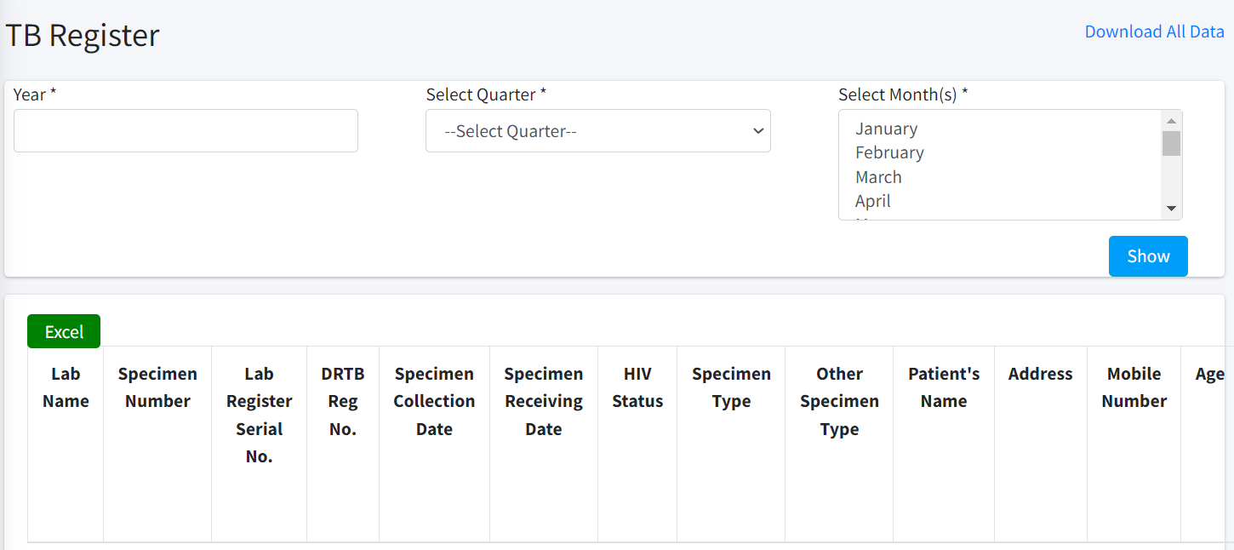
Culture tb register

Slide 42
Division LOGIN

Slide 43
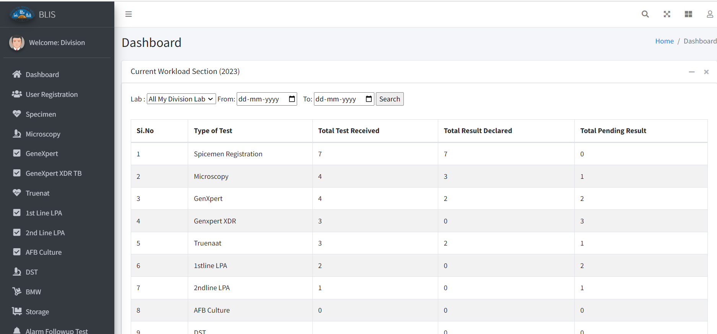
Division Dashboard

Slide 44
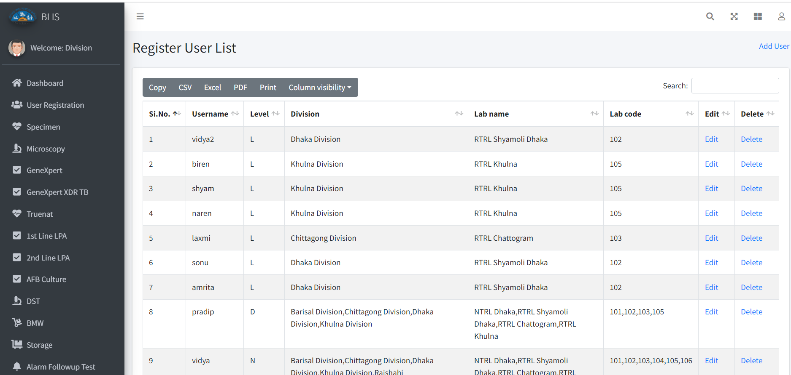
Division UserLIST

Slide 45
Other features
  Email notification
  Dash boards
  CBNAAT/Truenat Monthly Report 10A,10B
  Test request form with results (DR TB-6)
  Quality Indicator Test Wise
    Turn Around Time (TAT) indictors

Slide 46
PROPOSED PLAN FOR PILOT TESTING
Development and Pilot testing
  User Acceptance testing
  Hosting application
  Deployment and training
Pilot
Deployment and Training
Hosting
QC Check
Development
Bug resolution and customization
Project report
One month
One month
One month

